Slide 1
KV6002 – Terms of Reference
Group 21

Slide 2
Slide 1
- Information about client.
- Their initial ‘pitch’ (what they want us to develop).
- Introduce the group – who is in the team?
- How we gathered the requirements for the system and refined them.

Slide 3
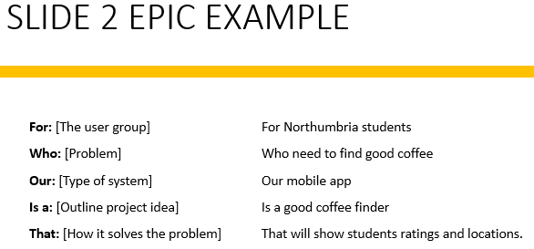
Slides 2&3
- Epic in specified format (AGILE).
- Team plan, outlining how features work together as a plan.
- Plan should include:
Details of the overall system.
Who will complete which subsystem.
How we intend to test the system.
Integration of the subsystems.
Project requirements – what equipment/software access do we need?
Potential commercial, economic, legal, ethical, social, professional factors.

Slide 4
Slides 2&3
- Epic in specified format (AGILE).
- Team plan, outlining how features work together as a plan.
- Plan should include:
Details of the overall system.
Who will complete which subsystem.
How we intend to test the system.
Integration of the subsystems.
Project requirements – what equipment/software access do we need?
Potential commercial, economic, legal, ethical, social, professional factors.

Slide 5
Slide 4
Intended users – 1 persona per group member

Slide 6
Persona #1
Intended users – 1 persona per group member

Slide 7
Persona #2
Intended users – 1 persona per group member

Slide 8
Persona #3
Intended users – 1 persona per group member

Slide 9
Persona #4
Intended users – 1 persona per group member

Slide 10
Persona #5
Intended users – 1 persona per group member

Slide 11
Slide 5
- Clear outline of the subsystem we are working on.
- 5 User stories (should be connected to each persona).
As a <role> I want <something> so that <benefit>.
- A clear outline of the tasks we intend to complete and the deliverables.

Slide 12
User Story 1

Slide 13
User Story 2

Slide 14
User Story 3

Slide 15
User Story 4

Slide 16
User Story 5

